Slide 1
EnergAIze: Revolutionizing Energy Forecasting for a Sustainable Future
Student Name:
AYUSH NAGAR (1022813)
VISHAL CHAUHAN

Slide 2
Defining the Subject
Demand Forecasting is the important area for business and country alike. Energy demand is increasing due to increase in technological advancement. It is a need of time to tackle climate with machine learning. Therefore, for this project the dataset that is chosen from “ Entsoe ANDOpenweather”.
Dataset is taken from these website and it contains 35064 rows and 29 columns. The dataset have 4 years of electrical consumption,
generation, pricing and weather data for spain. The links are given in references. The dataset have hourly data for electrical consumption and respective forecast by Transmission Service Opersator (TSO) such as Spanish esios Red Electric Espana (REE) for consumption and pricing.

Slide 3
Business need and problem statement
The problem being considered for the project is to predict or forecast energy demand
accurately in Spain. The research questions considered for this project are:
1. Which regression technique will accurately forecast the daily energy consumption demand using hourly period ?
2.How to accurately forecast energy demand 24 hour in advance compared to TSO?
3. Using Classification, determine what weather measurement and cities influence most the electric
demand, prices, and generation capacity?
The tools that will be used are Python jupyter, Tableau, R, Excel and others as needed.
The systematic data analysis process approach will be used for the project.
After date selection, initial analysis will be carried out followed by the exploratory analysis (EDA). Then
experimental design and model building will be carried out. Finally performance evaluation will
be done together with recommendations and conclusion.

Slide 4
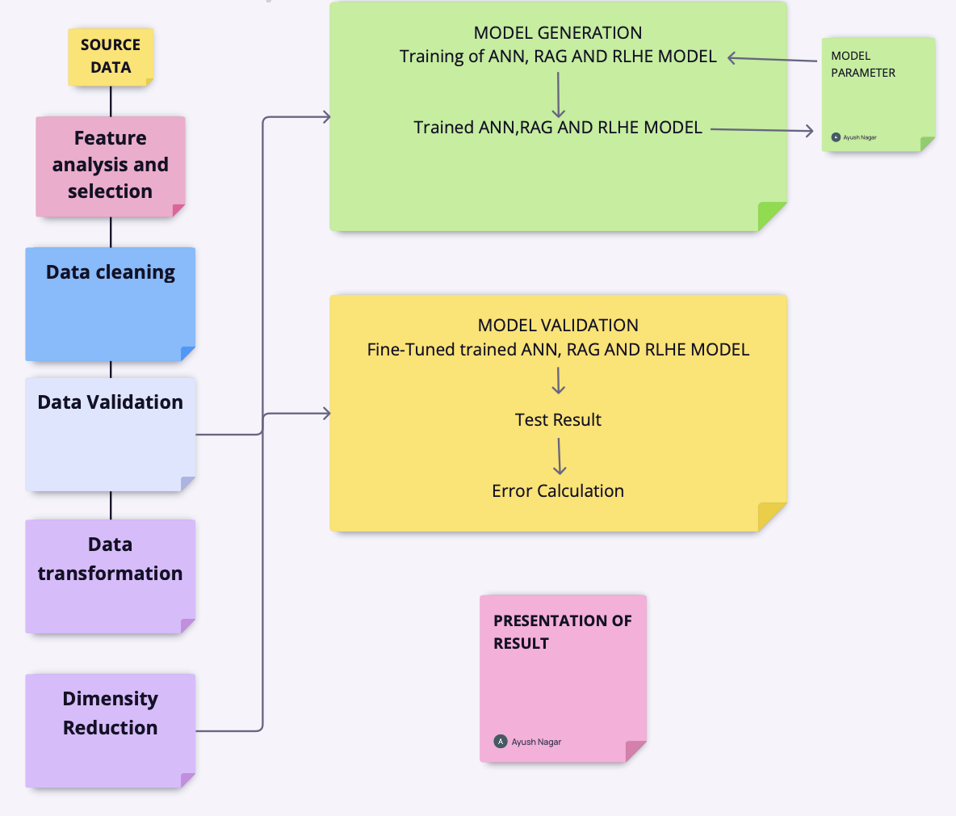
High-Level Architecture
;l

Slide 5
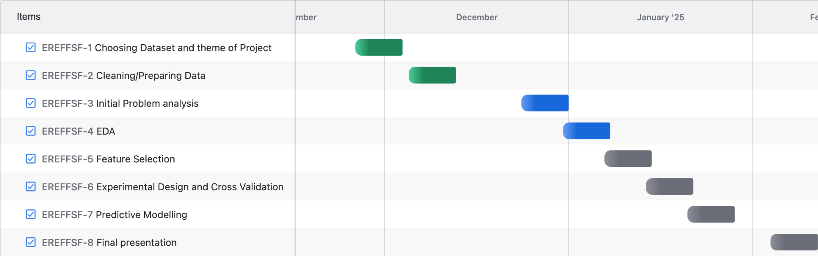
Gantt Chart

Slide 6
References:
Entsoe retrieved from https://transparency.entsoe.eu/dashboard/show
Openweather retrieved from https://openweathermap.org/api

Slide 7
Research Questions
1. Which regression technique will accurately forecast the daily
energy consumption demand using hourly period?
2. How to accurately forecast energy demand 24 hour in
advance compared to TSO?
3. Using Classification, how to accurately forecast daily energy
demand?

Slide 8
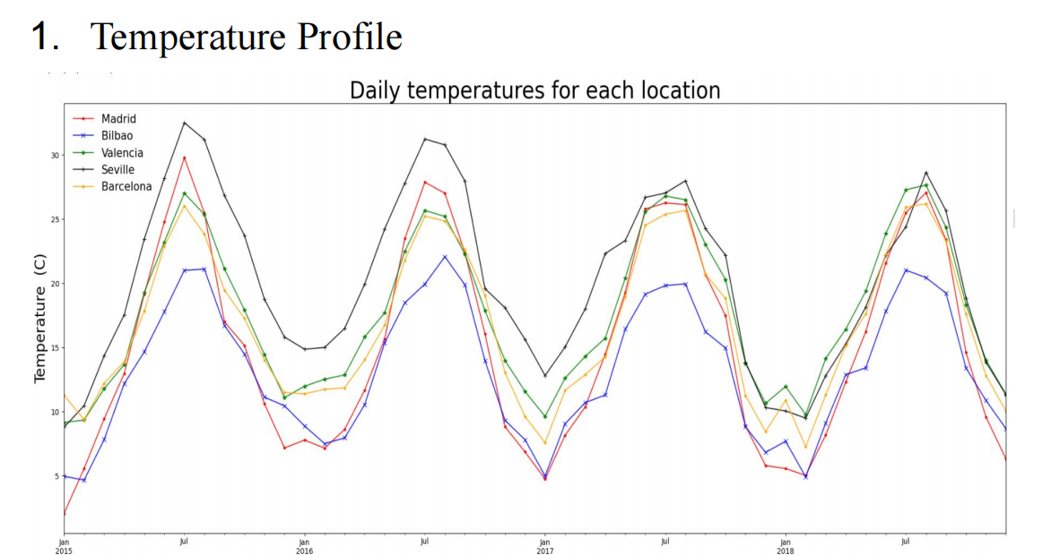
Trends and Patterns

Slide 9
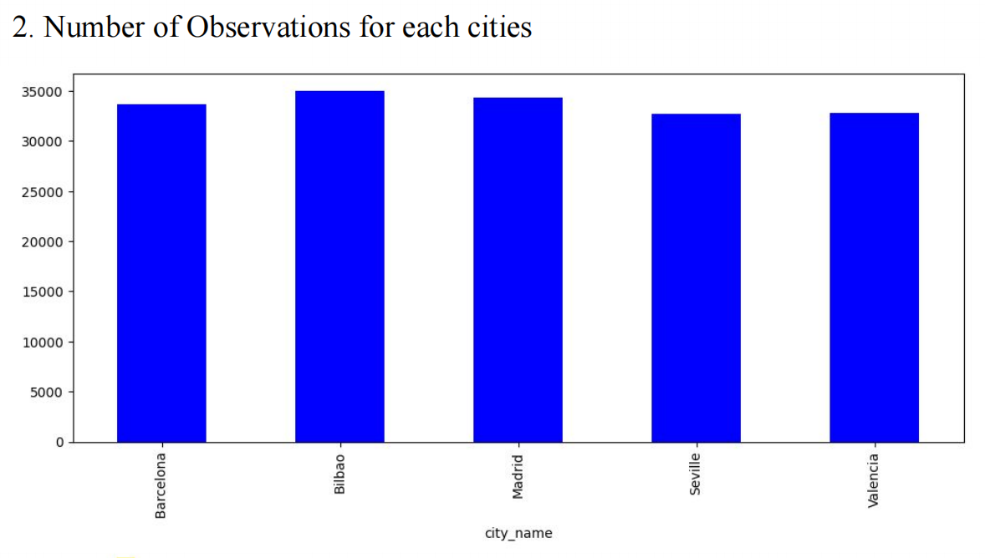
Trends and Patterns

Slide 10
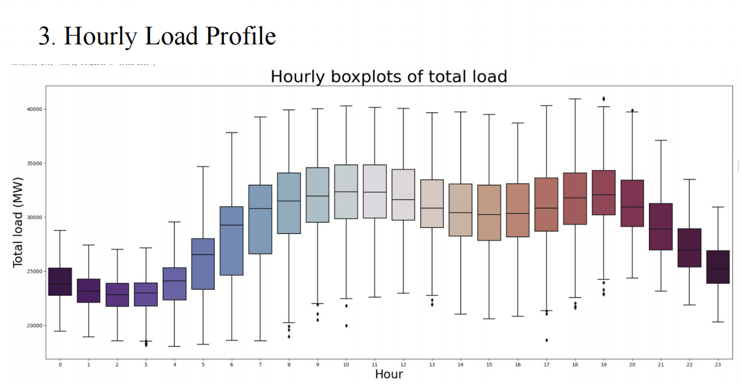
Trends and Patterns

Slide 11
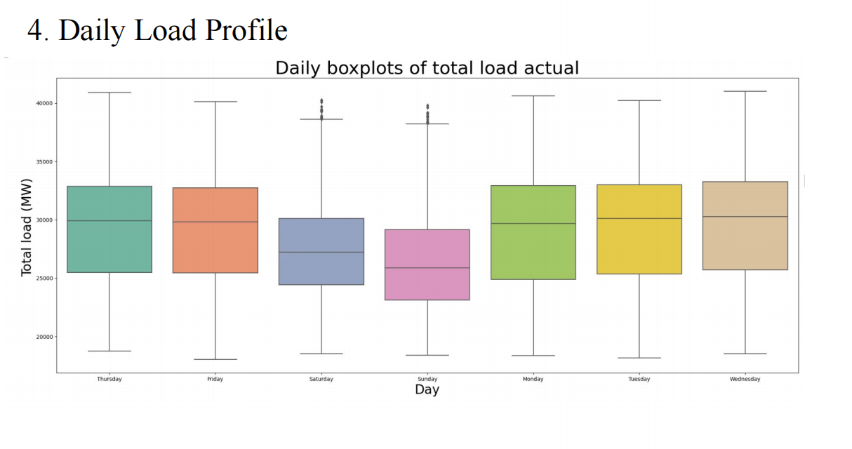
Trends and Patterns

Slide 12
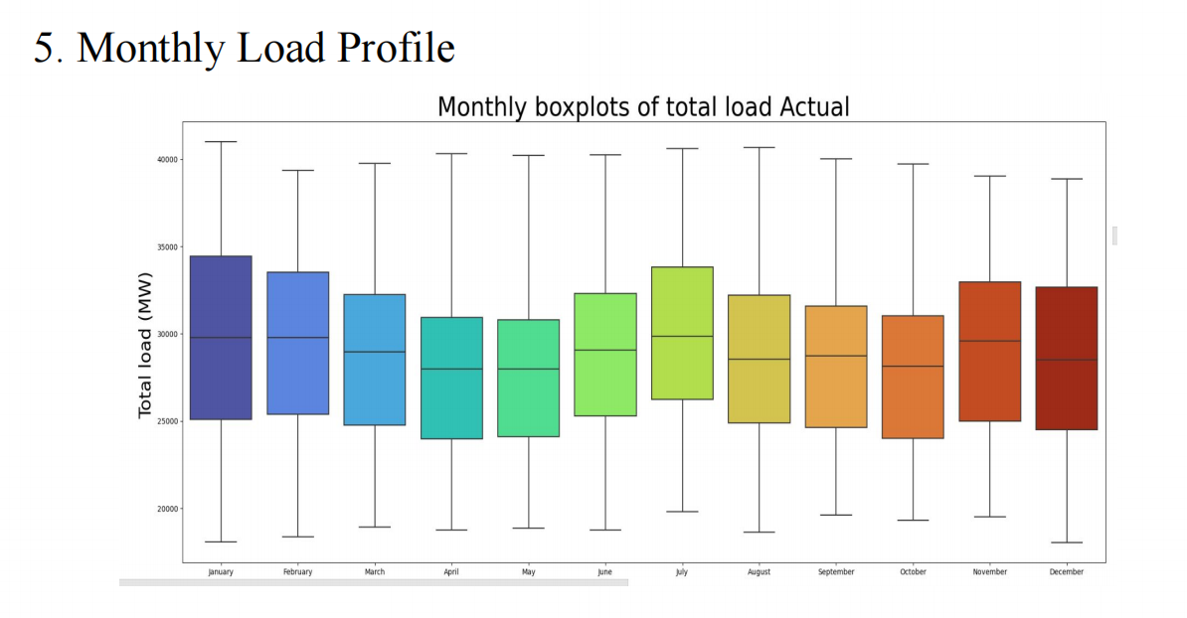
Trends and Patterns

Slide 13
Literature Review
Regression/Classification models considered are linear regression, Random Forest Regressor (RAG) and Artificial Neural Network (ANN)
Depending on case study, different models outperform other
Performance of models is evaluated using metric such as R2 and MSE
Performance of models is evaluated using metric such as accuracy, F1-score, Precision, and Recall for Classification analysis
Input parameters considered can be categorized into time variable, weather variable, and electricity usage variable

Slide 14
Data Preparation
Dataset is taken from two website consists of two big csv files
First is energy_dataset file which contains 35064 rows and 29 columns
Second is weather_features file which contains 178397 rows and 17 column
The dataset has four years (2015-2018) of electrical consumption, generation, pricing, and
weather data for five cities in Spain
First mean is taken across all 5 cities in Spain to make the second file matchable with first file
Then Both csv files are joined on common column for analysis
Columns with more than 99% missing values or 99 % zero are dropped
Redundant columns or categorical columns containing weather description are also dropped.

Slide 15
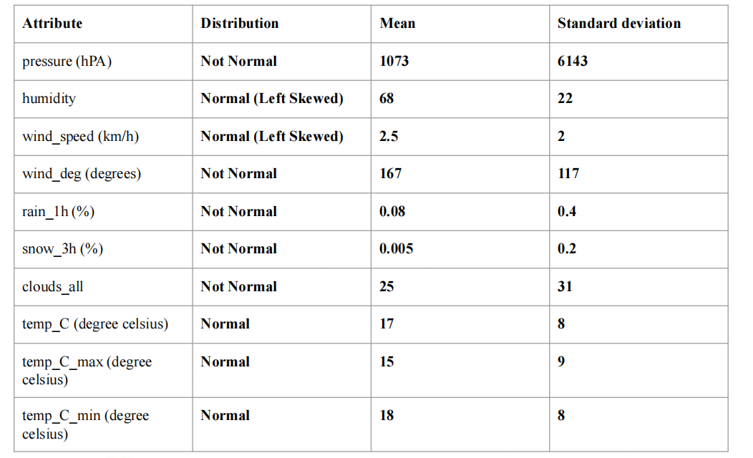
Descriptive Statistics

Slide 16
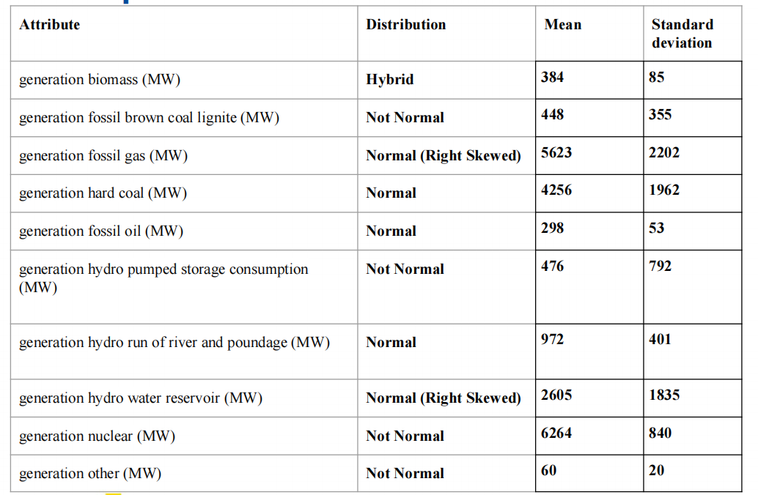
Descriptive Statistics

Slide 17
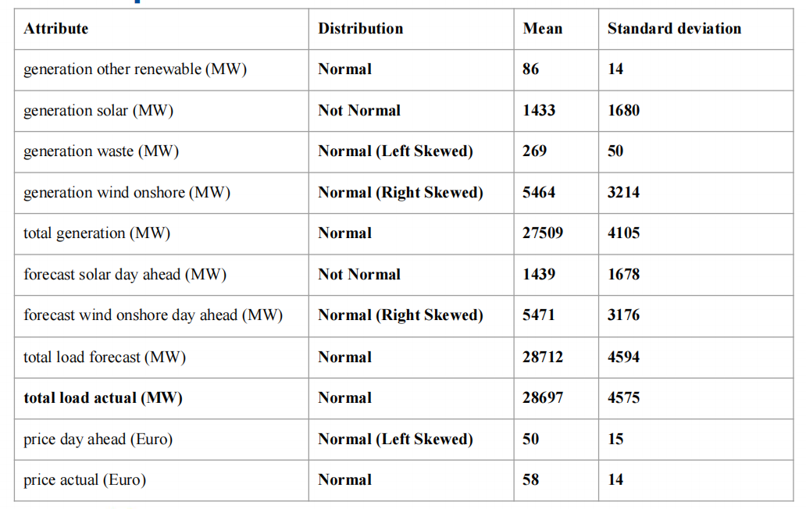
Descriptive Statistics

Slide 18
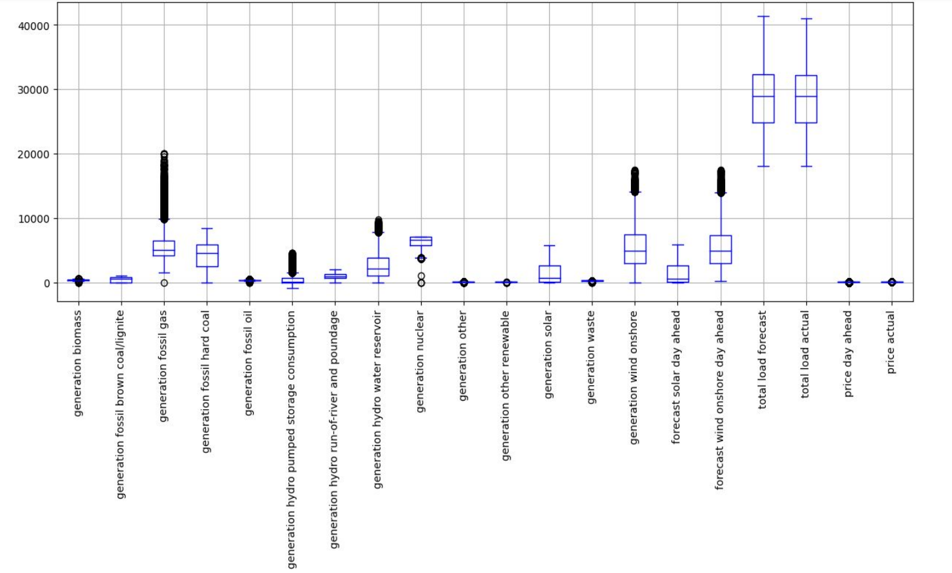
Box Plots

Slide 19
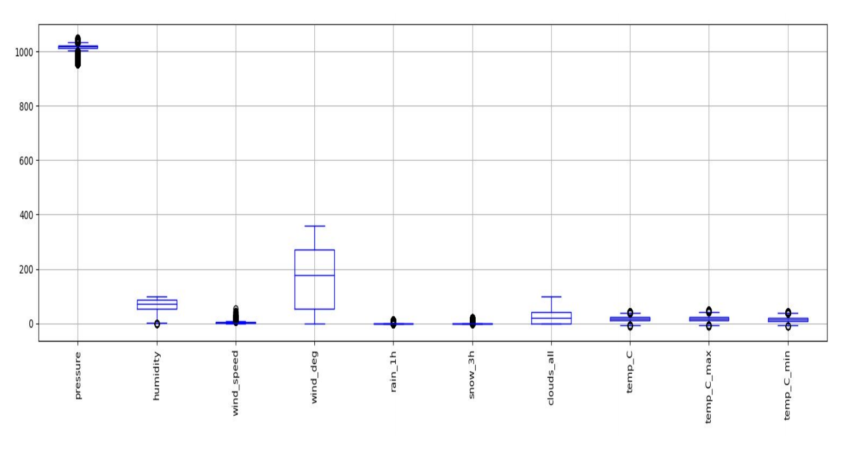
Box Plots Continued

Slide 20
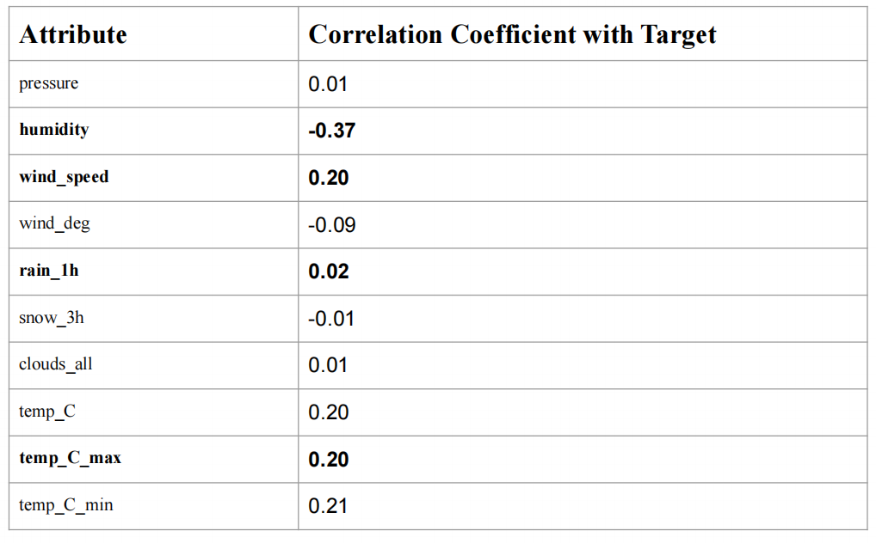
Correlation Matrix

Slide 21
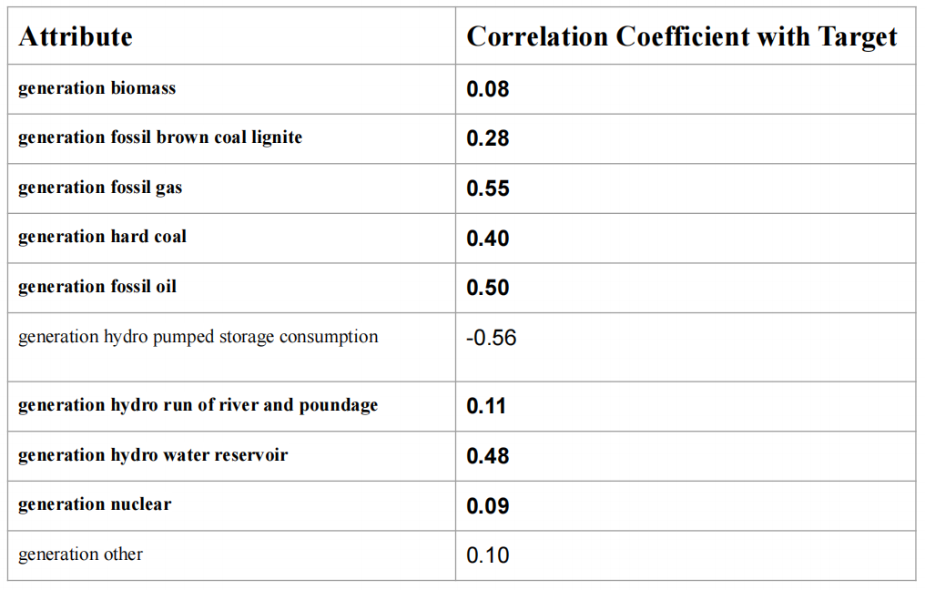
Correlation Matrix

Slide 22
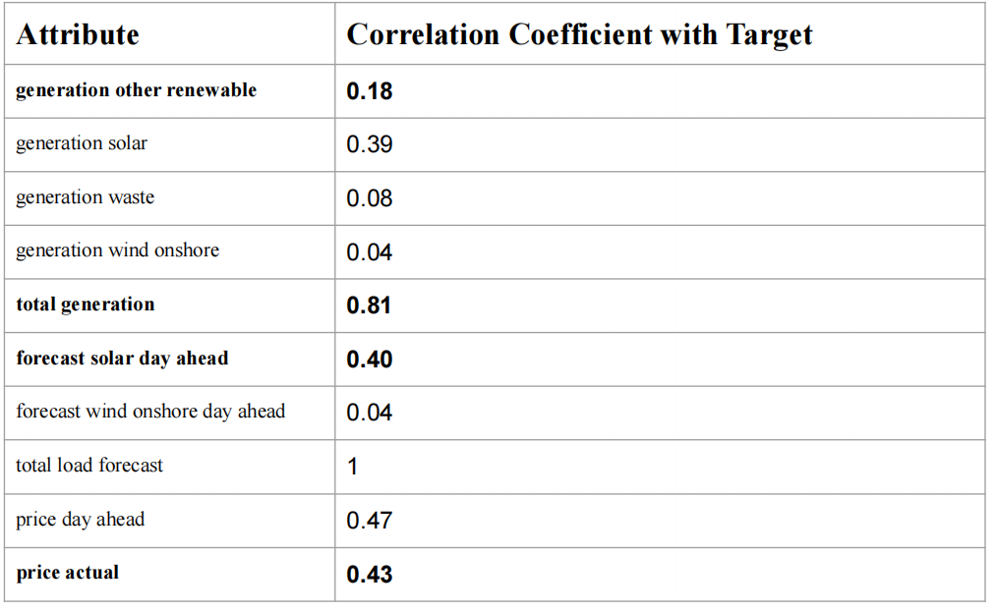
Correlation Matrix

Slide 23
Selected Features for Regression
● total generation
● humidity
● wind_speed
● rain_1h
● temp_C_max
● generation biomass
● generation fossil brown coal lignite
● generation fossil gas
● generation hard coal
● generation fossil oil
● generation hydro run of river and poundage
● generation hydro water reservoir
● generation nuclear
● generation other renewable
● forecast solar day ahead
● price actual

Slide 24
Predictive Modelling
Experimental design consist of 80:20 random split of data into training and testing
Data frame for modelling consist of 16 predictors and 1 target column
Target variable is total load actual measured in Megawatts (MW)
The total number of rows in dataframe are 34468
Therefore 27574 of 80% of records are for training and rest are for testing
For Q1, data is sampled on hourly basis while for Q2 and 3 it is resampled on daily basis
After resampling to daily basis the number of rows reduced to 1460

Slide 25
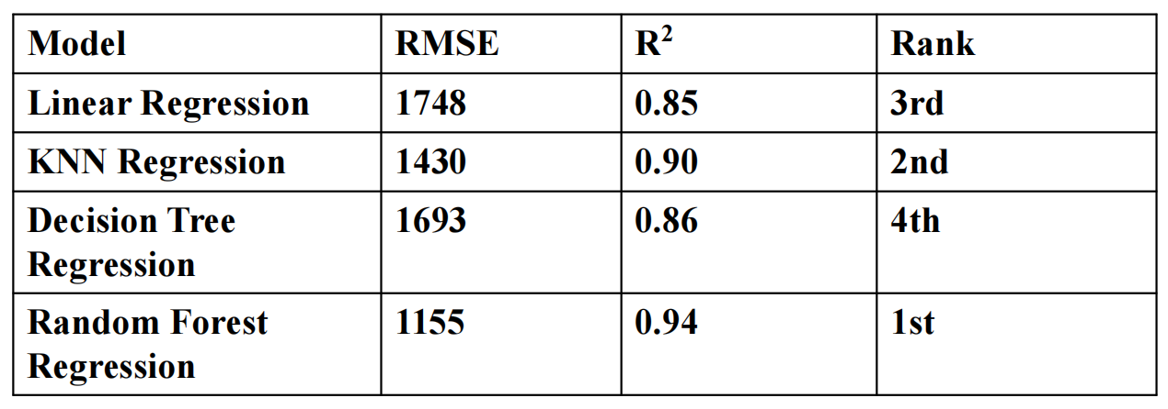
Regression Analysis - Hourly Period

Slide 26
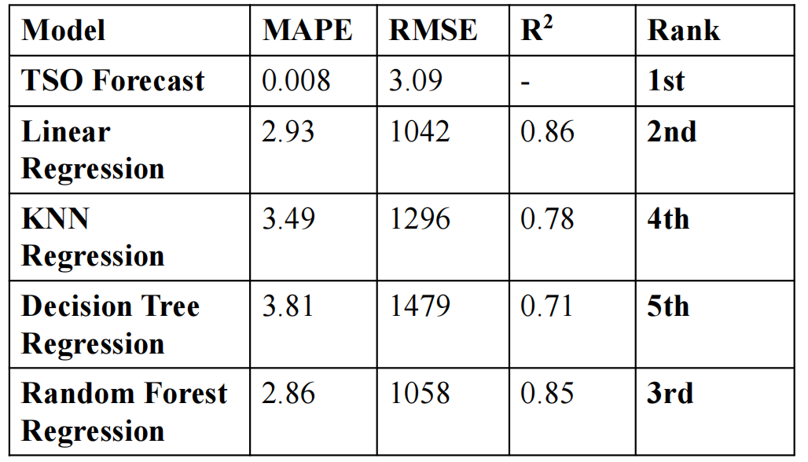
Regression Analysis - Daily Period

Slide 27
Classification Analysis
● Target : high_load_level
● Binary classification
● Almost no class imbalance
● Data is normalized

Slide 28
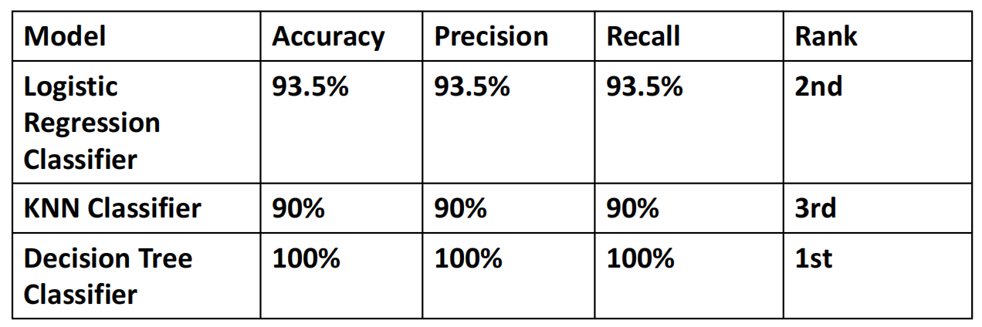
Classification Analysis - Daily Period

Slide 29
Time Series Analysis - Aroma and Sarimax
Model | MSE | MAE | RMSE | R²
ARIMA | 6,652,580,160.18 | 65,461.70 | 81,563.35 | -0.26
SARIMAX | 22,113,074,322.49 | 133,714.98 | 148,704.65 | -3.19

Slide 30
Q-1 Which regression technique will accurately forecast the daily energy consumption demand using an hourly period?
From the Regression Analysis - Hourly Period, our evaluated four models:
Linear Regression (RMSE = 1748, R² = 0.85, Rank: 3rd)
KNN Regression (RMSE = 1430, R² = 0.90, Rank: 2nd)
Decision Tree Regression (RMSE = 1693, R² = 0.86, Rank: 4th)
Random Forest Regression (RMSE = 1155, R² = 0.94, Rank: 1st)
Key Insight:
The Random Forest Regression model outperforms all others, with the lowest RMSE (1155) and the highest R² (0.94).
A lower RMSE indicates that Random Forest has the least prediction error, and a higher R² means it explains 94% of the variance in energy consumption demand.
Why Random Forest is Best for Hourly Forecasting?
It captures non-linear relationships between features and energy consumption.
It is robust to noise and missing data, unlike Linear Regression.
Unlike Decision Trees, it prevents overfitting by using multiple trees (ensemble learning).
It works well with high-dimensional datasets, which is useful for energy forecasting with multiple weather, time-based, and regional factors.
Final Conclusion: For hourly energy demand forecasting, the Random Forest Regression model is the most accurate and reliable technique.

Slide 31
2. How to accurately forecast energy demand 24 hours in advance compared to TSO?
From the Regression Analysis - Daily Period, the TSO (Transmission System Operator) Forecast had the best performance:
MAPE = 0.008 (Extremely low error)
RMSE = 3.09 (Highly accurate)
Ranked 1st
Among the machine learning models, Random Forest Regression performed best:
MAPE = 2.86 (Better than other ML models but higher than TSO)
RMSE = 1058 (Higher than TSO, but still relatively low)
R² = 0.85 (Indicates strong predictive power)
Ranked 3rd
Key Insight:
The TSO Forecast is the gold standard but may rely on proprietary models and additional real-time grid data unavailable for ML models.
Random Forest Regression is the best alternative among machine learning models.

Slide 32
3. Using Classification, determine what weather measurements and cities influence electrical demand, prices, and generation capacity?
From the Classification Analysis - Daily Period, the best-performing model was:
Decision Tree Classifier (100% Accuracy, Precision, Recall, Ranked 1st)
Since Decision Trees provide interpretable feature importance, they help identify the most influential factors affecting electricity demand, pricing, and generation capacity.
Key Insight:
To determine the most important weather factors and cities, you should analyze the feature importance scores from the Decision Tree Classifier.

Slide 33
3. Using Classification, determine what weather measurements and cities influence electrical demand, prices, and generation capacity?(Count.)
Likely Influential Weather Variables (Based on Energy Demand Studies):
Temperature (°C):
Strong correlation with energy demand (higher demand in extreme cold/hot weather).
Humidity (%):
Affects cooling/heating needs, influencing demand patterns.
Wind Speed (m/s):
Impacts renewable energy generation (e.g., wind turbines).
Solar Radiation (W/m²):
Affects solar power generation capacity.
Precipitation (mm):
Impacts energy infrastructure and demand variations.
Cities with the Most Influence:
Highly populated urban areas → Higher electricity demand and price volatility.
Industrial hubs → Consistent, high energy consumption.
Renewable energy hubs → Strong impact on energy generation and pricing.

Slide 34
Final Summary & Takeaways
Research Question | Answer / Key Findings
Which regression technique is best for hourly energy forecasting? | Random Forest Regression (RMSE: 1155, R²: 0.94, Best Performance).
How to improve 24-hour ahead energy forecasting accuracy beyond TSO? | TSO has the lowest error (RMSE: 3.09, MAPE: 0.008). The best alternative ML model is Random Forest Regression (MAPE: 2.86, RMSE: 1058, R²: 0.85). Improvements include feature engineering, hybrid models, and deep learning (LSTM).
Which weather factors and cities influence electricity demand, price, and generation? | Decision Tree Classifier (100% Accuracy) identifies key factors. Likely influential weather variables: Temperature, Humidity, Wind Speed, Solar Radiation, and Precipitation. Cities with high demand: Urban centers, industrial hubs, and renewable energy zones.

